Slide 1
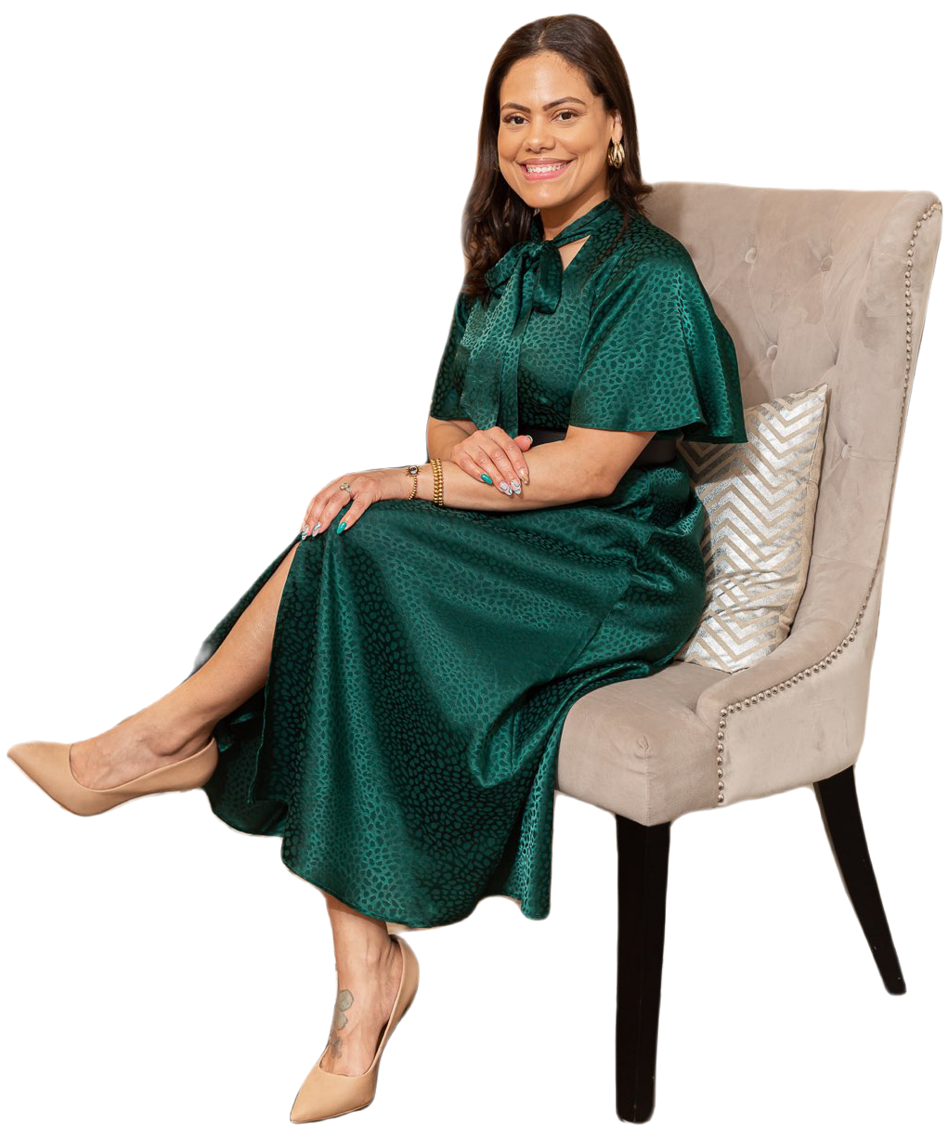
Erica McMillon

Slide 2
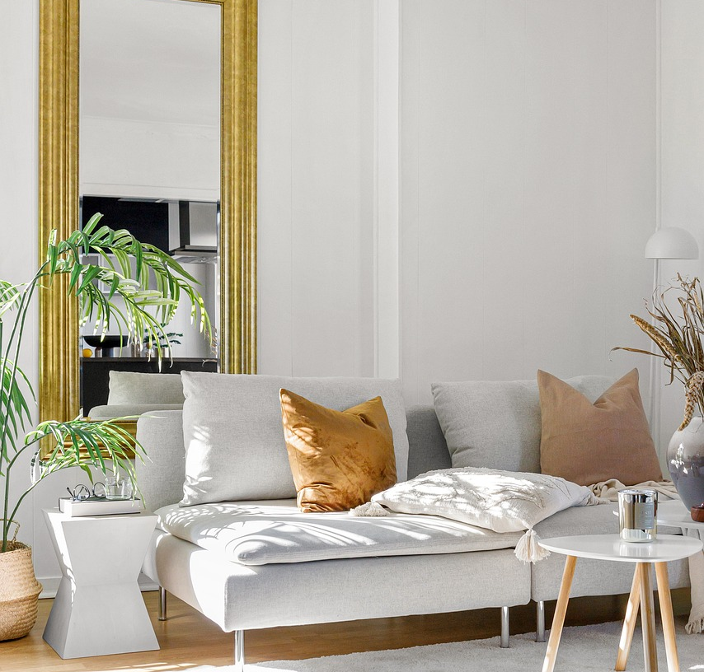
TEXTILES & HOW TO USE THEM IN YOUR SPACES:
Examples of textiles are:
Curtains
Throw blankets
Throw pillows
Sofa fabrics
Décor accents
I recommend to add fabrics that pair well together but also help create the style tone you’re looking to achieve.

Slide 3
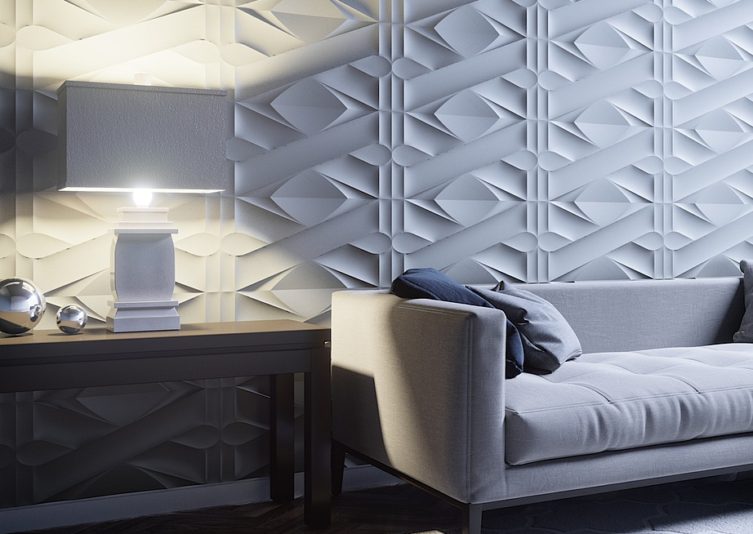
TEXTILES & HOW TO USE THEM IN YOUR SPACES:
Glam & Contemporary Style
Velvet fabrics
Glistening metallics
Satin
Faux fur
Coastal or Scandinavian
Linens
Jute
Woods
Rattan
Lighter Tones (blue, green, beige, & white)
Traditional Styles
Cotton
Silk
Polyester
Woven materials
Farmhouse Style
Reclaimed wood
Wrought iron accents
Plaid
Vintage pieces

Slide 4
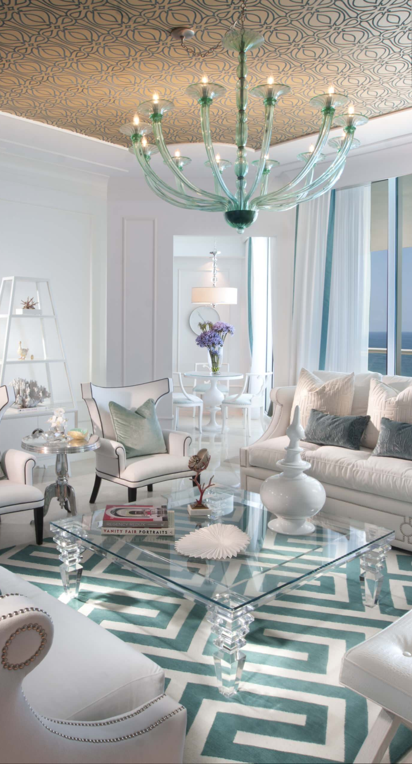
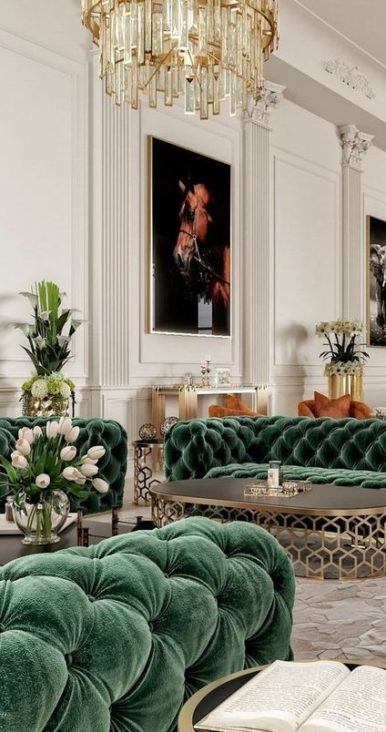
GLAM & CONTEMPORARY STYLE

Slide 5
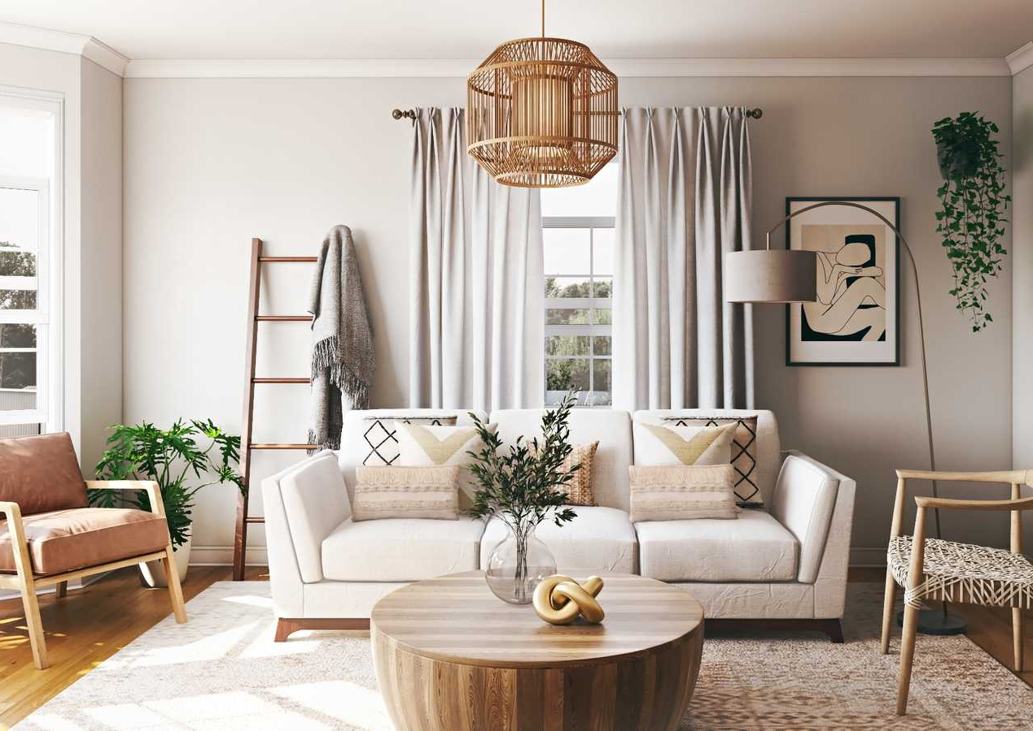
COASTAL OR SCANDANAVIAN

Slide 6
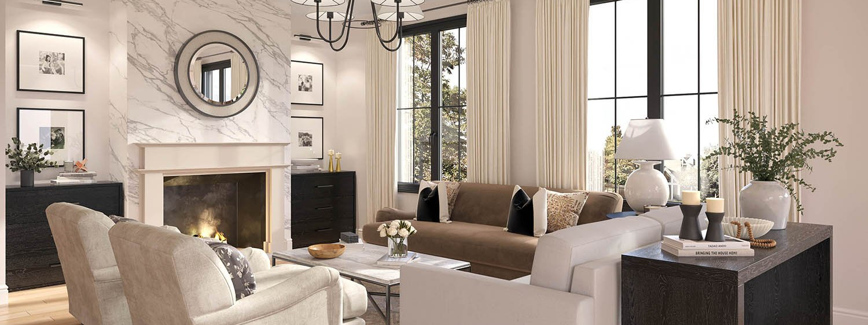
TRADITIONAL

Slide 7
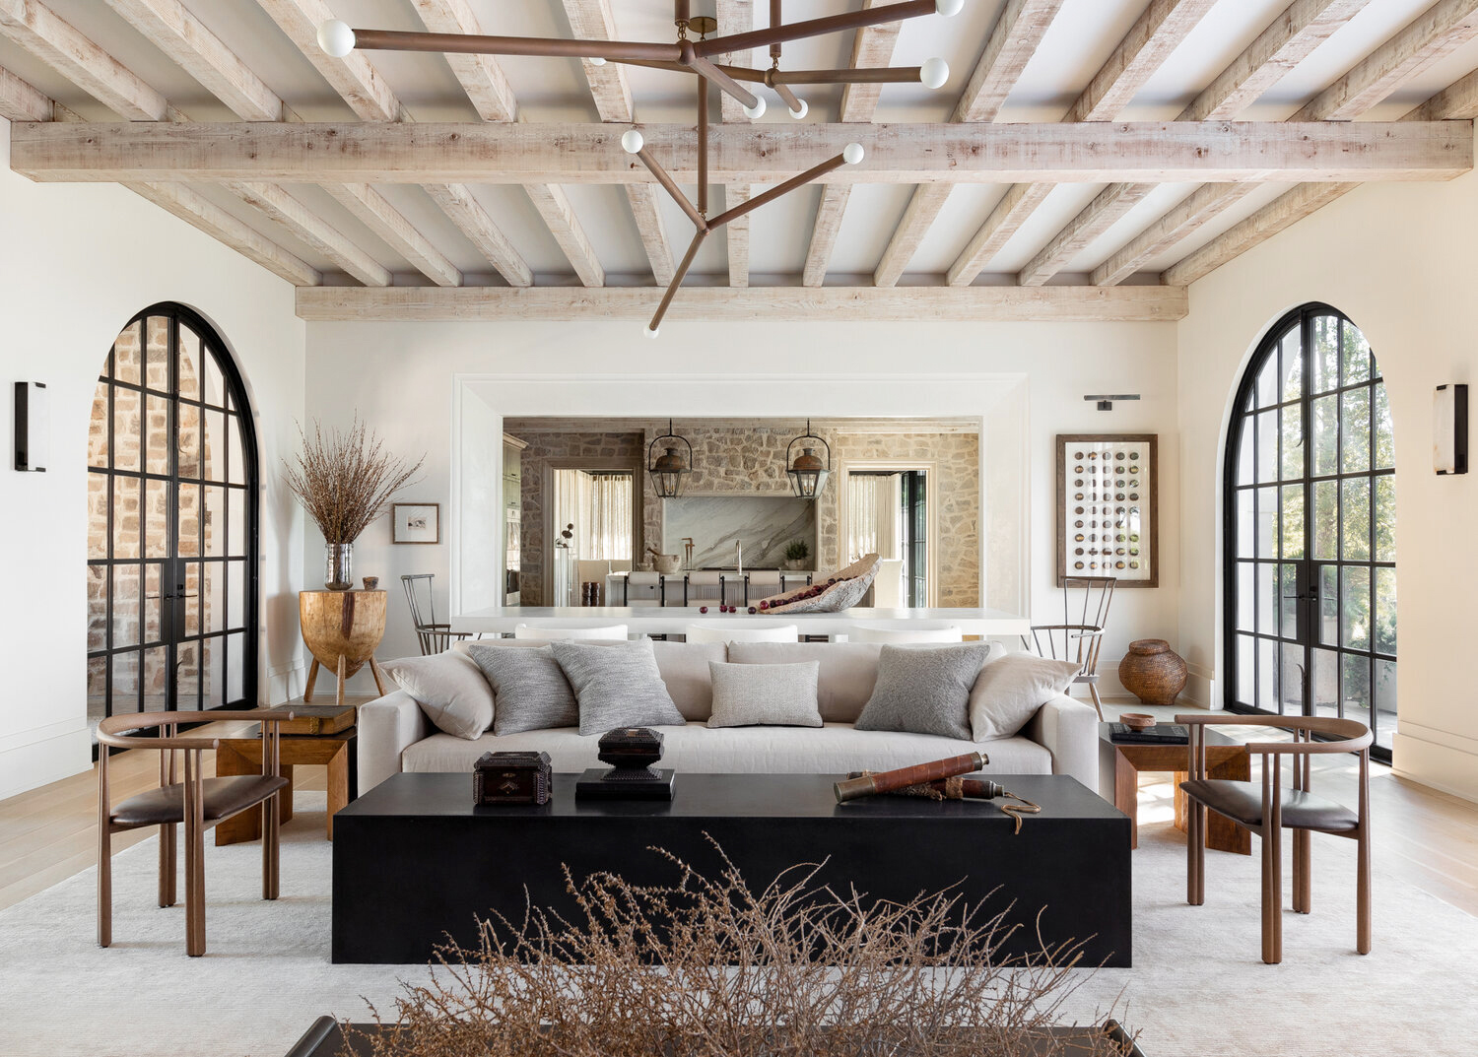
FARMHOUSE STYLE

Slide 8
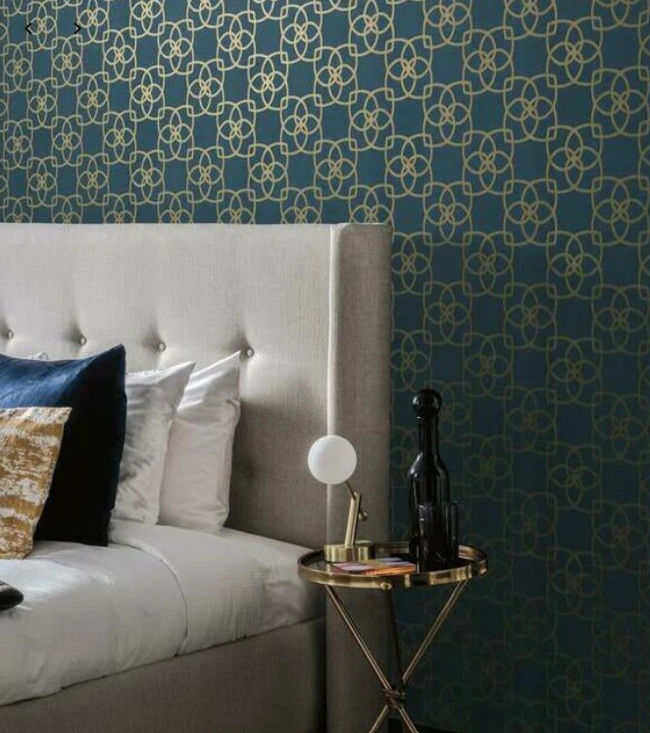
WALLPAPER
All wallpapers add depth & style to spaces which is why I use it in most of my designs. It is one of my two design signatures.
The wallpaper patterns, colors, & fabrics create an effect of increasing space & a clear point of attention.
How I use wallpaper in my designs
Ceilings
Accent walls
Entire powder rooms

Slide 9
PROPER USE OF PATTERNS
When designing a space there shouldn’t be more than three patterns in one dedicated space.
You want each pattern to be appreciated without either of them overpowering the other.
I recommend using your patterns in the following areas.
OPTION 1
Accent rug
Curtains
Throw pillows
OPTION 2
Wallpaper
Accent Rug
Throw pillows
OPTION 3
Accent wall
Throw pillows
OPTION 4 (Kitchens & Bathrooms)
Tiles
Counters
Floors

Slide 10
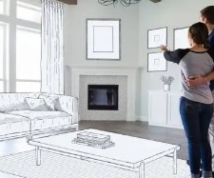
SPACE PLANNING & FURNITURE LAYOUT
Map out your space
Arrange your pieces in a balanced way
Highlight a focal point
Consider traffic flow
My favorite part – Use lighting to your advantage. Natural or installed lighting.

Slide 11
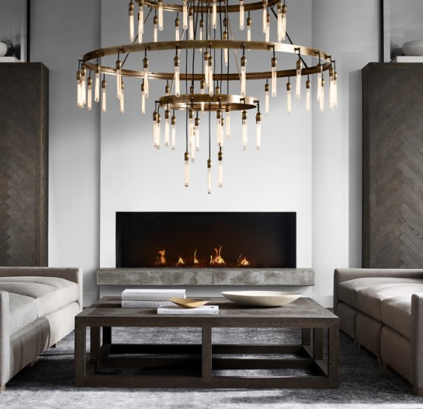
The importance of lighting
Lighting can make or break a design. A well-lit room can make it feel spacious & inviting while a poorly lit room can make it feel cramped & uninviting.
Artificial light creates visual stimulation allowing our eyes to naturally gravitate to the brightest point in a room. This is why we use light fixtures to accentuate specific items we want to enhance in a space like art or family photos. Light has the capacity to create an atmosphere much more than furniture or décor can. It recreates a unique experience & ambience. Lighting is important in a space because it’s known to play a significant influence on the appearance of colors in a space. It is the jewelry to your outfit.

Slide 12
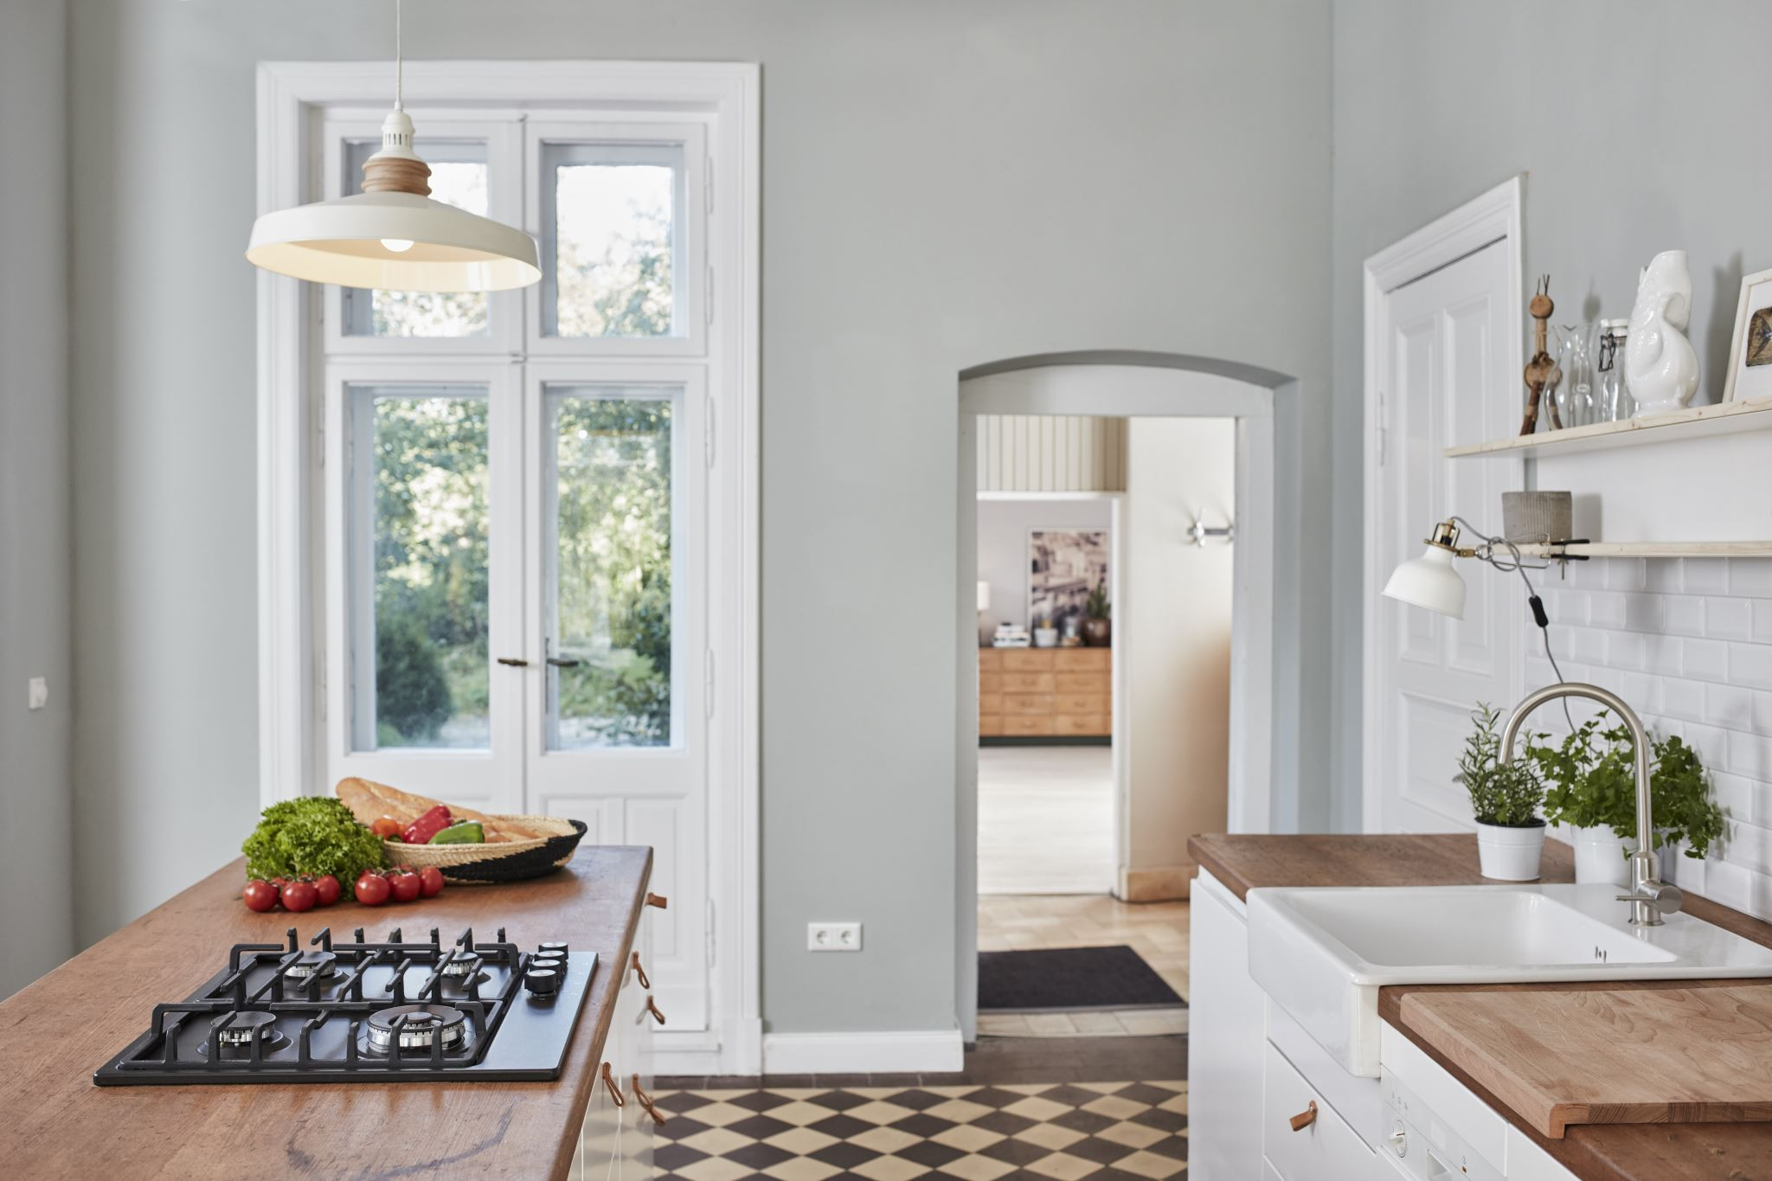
WHAT INVESTMENTS ADD VALUE?
A quality home office
Finished basement
Open floor plans
Custom built-ins
Updated kitchen
Fresh paint
Updated bathrooms
Quality light fixtures
Updated flooring
Crown molding

Slide 13
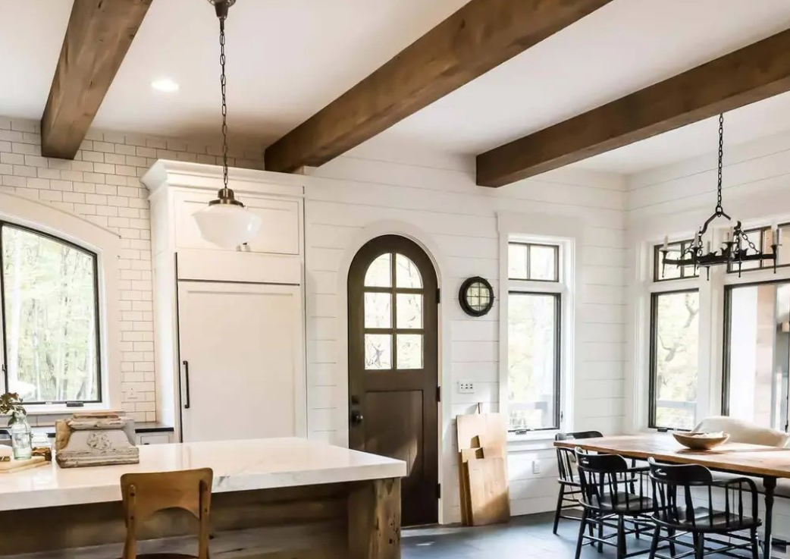
HOW TO USE A CEILING TO REDEFINE A ROOM
Three Ways to Use a Ceiling
Wallpaper
Coffered ceiling
Wood planking
Wood beams
Using one of these options will help set the tone in your space. It will become a focal point and create a luxury feel to the room.

Slide 14
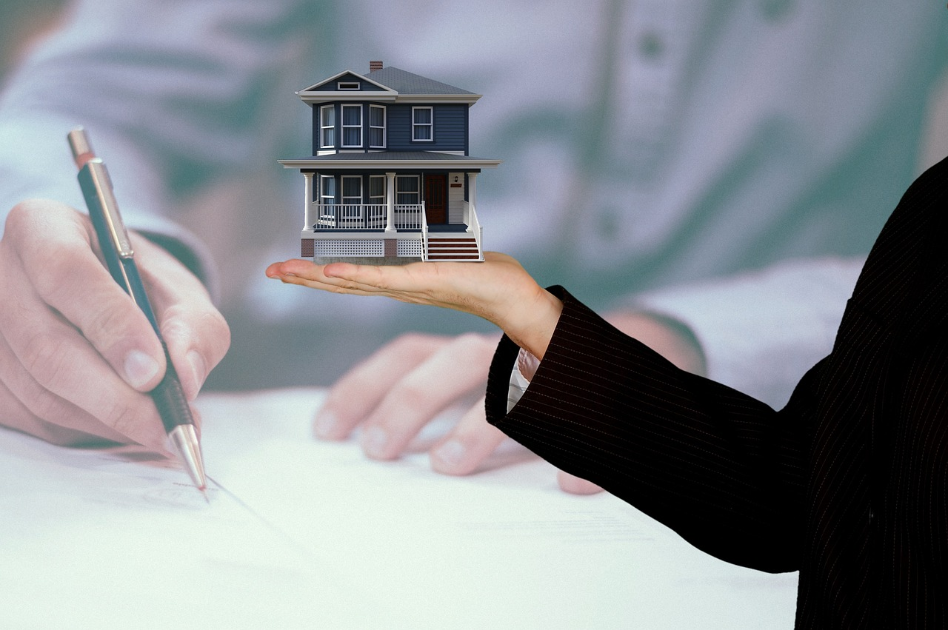
FOR REALTORS TIPS FOR TOURING WITH CLIENTS
Lighting options
Shorter ceilings
Smaller spaces

Slide 15
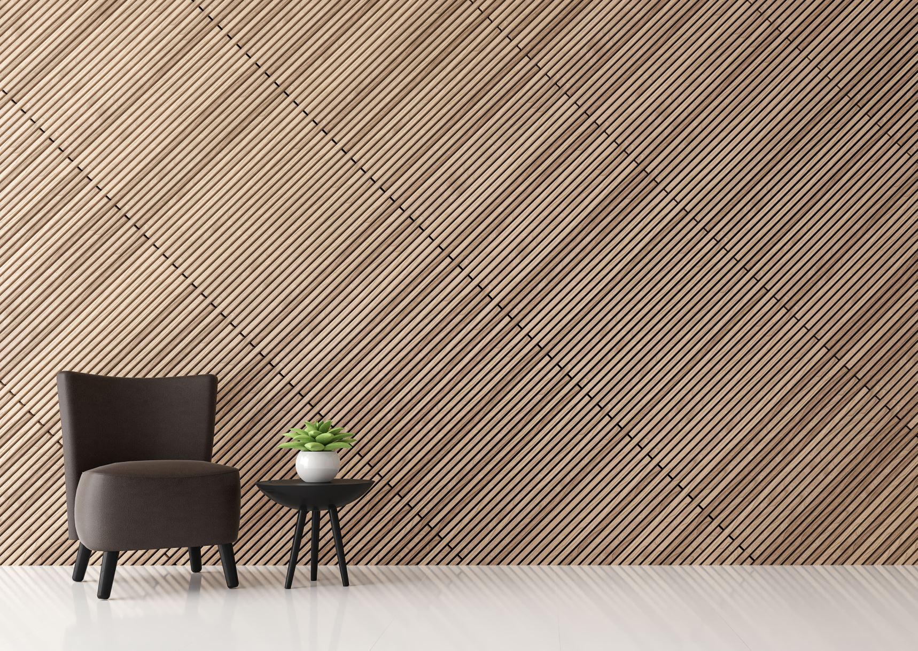
FOR REALTORS
Property Preparation: Before listing a property for sale, a realtor should consult with an interior designer to make the property more visually appealing to potential buyers. The designer can suggest simple changes like decluttering, staging, and minor decor adjustments that create a more attractive and welcoming environment.
Staging: Interior designers specialize in creating spaces that appeal to a wide range of potential buyers. By arranging furniture, decor, and accessories in a way that highlights the property's best features, interior designers can make the space look more inviting and functional. Staging can help potential buyers visualize themselves living in the space and can lead to quicker sales.
Enhancing Value: Interior designers can provide insights into cost-effective updates or renovations that can increase the $$value of a property$$. This might include suggesting paint colors, flooring options, kitchen and bathroom updates, or other design changes that align with current trends and buyer preferences.

Slide 16
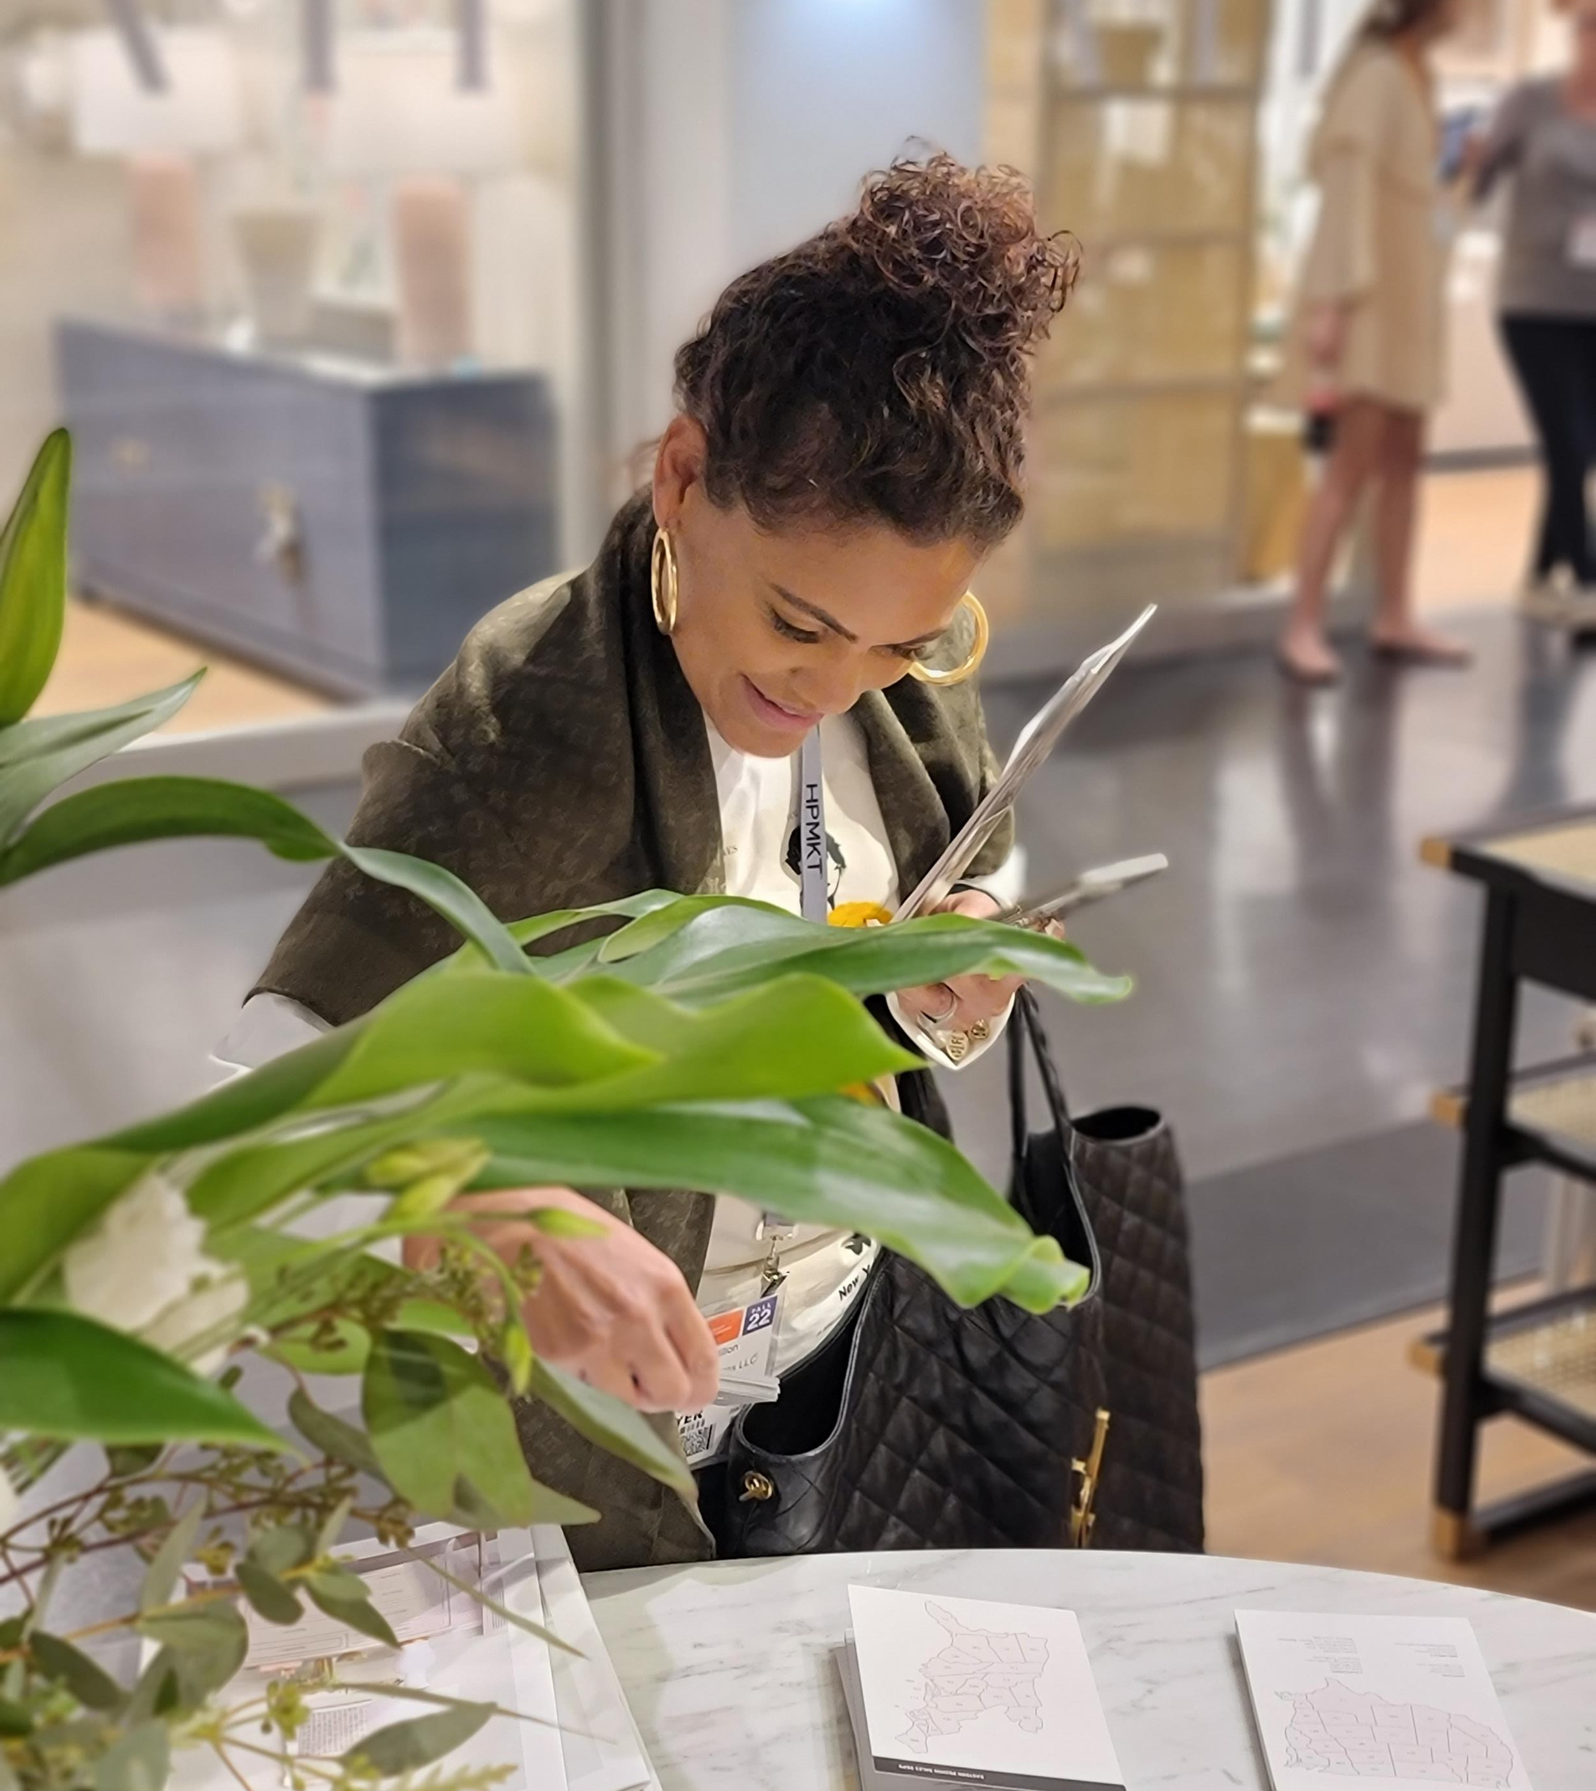
Why is it important to hire an interior designer?
Expertise and Creativity: We are trained professionals who have a deep understanding of design principles, color theory, spatial arrangements, and aesthetics. We bring a wealth of knowledge and creativity to the table, helping you achieve a unique and well-thought-out design that suits your preferences.
Personalized Design: We work closely with you to understand your lifestyle, tastes, and specific needs. We tailor our designs to your individual requirements, ensuring that the space not only looks beautiful but is also functional and practical.
Time and Money Savings: While it may seem counterintuitive, hiring a designer like me will save you money in the long run. I have access to a wide network of suppliers, vendors, and contractors, often securing discounts that you wouldn't be able to obtain on your own. I can also help you avoid costly mistakes by making informed decisions.
Efficient Planning: We are experts at space planning. We can optimize the layout of a room or space to maximize functionality and flow, ensuring that every square inch is used effectively. This is especially valuable in smaller or oddly shaped spaces.
Attention to Detail: We have a keen eye for detail, ensuring that every element, from furniture selection and placement to lighting and accessories, is meticulously chosen to create a cohesive and harmonious design.
Access to Resources: We have access to a vast array of resources, including exclusive furniture and decor options that may not be readily available to the general public. This can result in a more unique and custom-designed space.

Slide 17
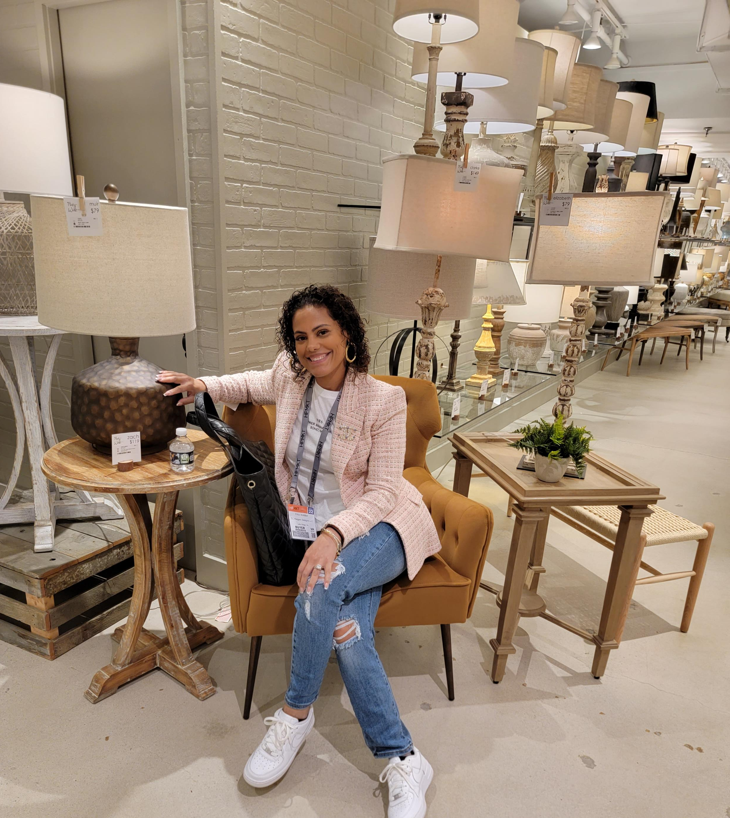
Why is it important to hire an interior designer?
Project Management: Designers take on the role of project managers, overseeing every aspect of the design process. We coordinate with contractors, craftsmen, and suppliers to ensure that the project runs smoothly and is completed on time and within budget.
Stress Reduction: Renovating or decorating a space can be a stressful and time-consuming endeavor. By hiring an interior designer, you can offload much of the stress onto a professional like me who can manage the project efficiently and make the process enjoyable.
Increased Property Value: A well-designed interior can significantly enhance the value of your property. Whether you're planning to sell or just want to increase the overall worth of your home, an interior designer can help you make the right investments in your space.
Aesthetically Pleasing Results: Ultimately, interior designers have the expertise and experience to create spaces that are not only functional but also aesthetically pleasing. They have a trained eye for color, proportion, and style, ensuring that your space reflects your taste and looks stunning.

Slide 18
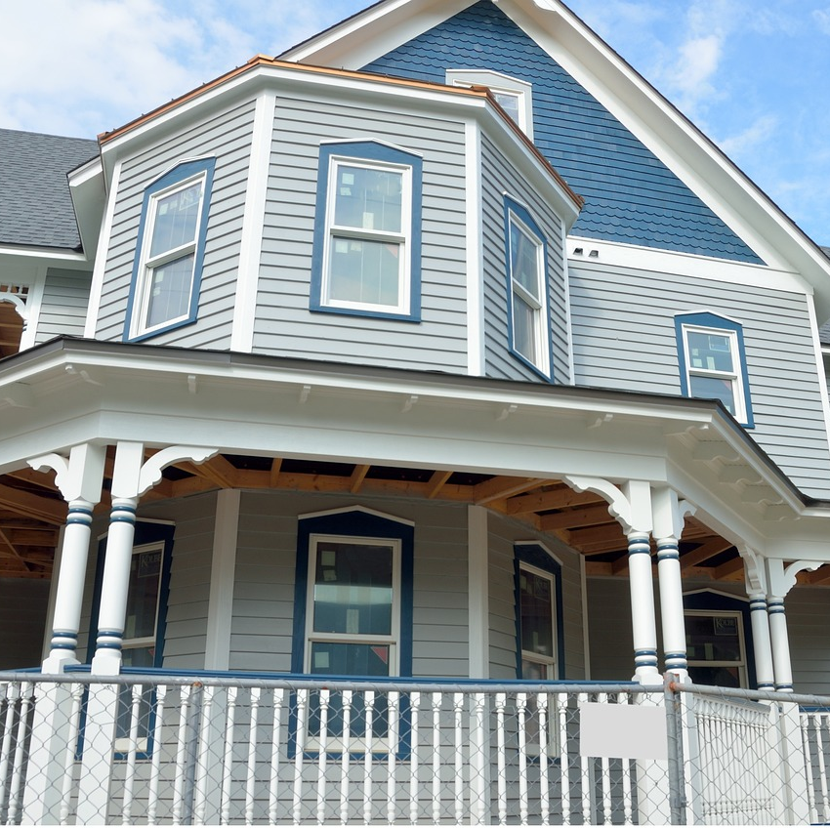
I GO BEYOND INTERIOR DESIGN
Supplier of the following:
Tile
Furniture
Lighting
Wallpaper
Countertops
Cabinetry
Flooring
Demo & Reno (Trusted Contractors)
Decks & Patios
Event planning

Slide 19
This concludes our interior design event. - Take photos at the event sign - Take photos with Erica - Post and tag your photos on social media ECElegantDesigns

Slide 20
THANK YOU ALL SO MUCH FOR COMING! ???? QUESTIONS ????

